Slide 1

STONEHOUSE METHODIST
CHURCH
A BRONZE AWARD
ECO CHURCH
20th February 2021

Slide 2
An Introduction to Eco Church
Eco Church was founded in 2016 by A Rocha UK and is an award scheme for churches of all denominations in England and Wales who want to demonstrate that the gospel is good news for God’s earth. A Rocha UK (ARUK) is a Christian charity working for the protection and restoration of the natural world and committed to equipping Christians and churches in the UK to care for the environment as an integral part of loving their neighbours and following God faithfully.
Stonehouse Methodist Church registered with the scheme in February 2019 and completed the initial Eco Survey to gauge where we were in relation to the three award levels.
There are five categories in the survey and we have to reach the required level in each before applying for an award. The categories are:
- Worship & Teaching
- Buildings
- Land
- Community & GLobal Engagement and
- Lifestyle

Slide 3


We initially scored well in some categories and formed a small Eco Church Team to plan monthly activities and events to improve our score in those areas where we had not reached Bronze level.
​These included a litter pick and garden tidy up, doing bulb planting with our youth club, putting up bird feeders and committing to hold a Climate Sunday service each year.
We are also a Fairtrade Church having supported the Fairtrade movement by serving Fairly traded tea, coffee and sugar at church events and selling Traidcraft goods for the last 20 years. We made a regular contribution to Toilet Twinning for many years and now support the Live Fair project supporting women coffee growers in Africa.
www.toilettwinning.org

Slide 4

In February 2020, having reached the required level in each category, we submitted our application for a Bronze Award and as we went into Lockdown in March, were delighted to receive an email from A Rocha UK confirming our Award.
This really encouraged us to keep working on our Eco Church projects despite not being able to meet in Church for services for many months. (We have yet to officially have our Certificate presentation!)

Slide 5
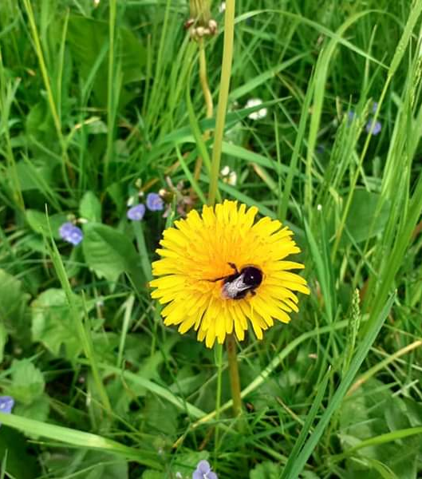
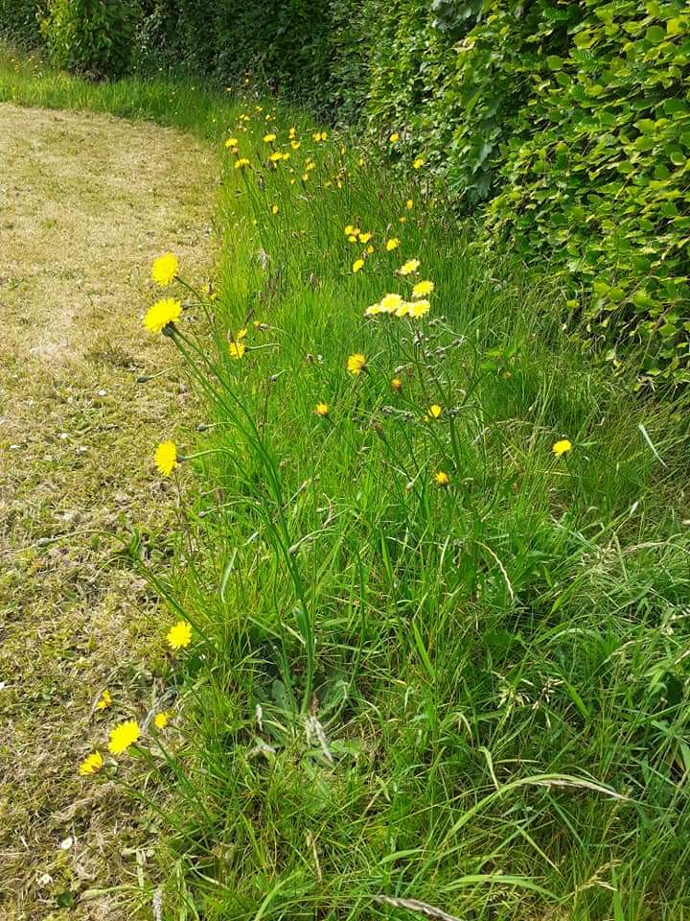
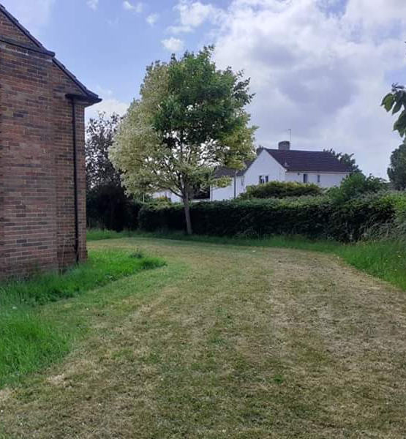
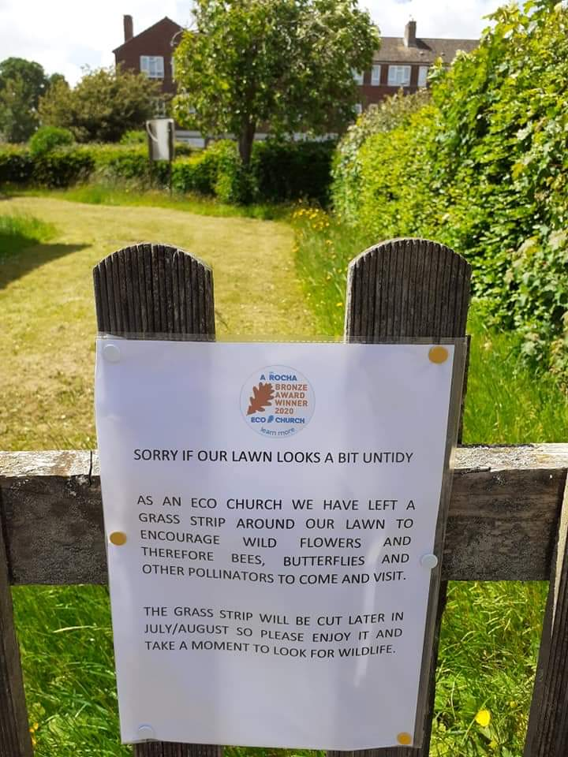
We have a good sized lawn at our church with a beech hedge around it and a couple of trees. There was considerable scope to improve this area so in Summer 2020 we asked our gardener to leave a 1 metre strip unmowed around the edge of the lawn for the grass to grow long and see what wild flowers might come up.
We were rewarded with many bees, butterflies and other pollinating insects arriving in the garden.

Slide 6
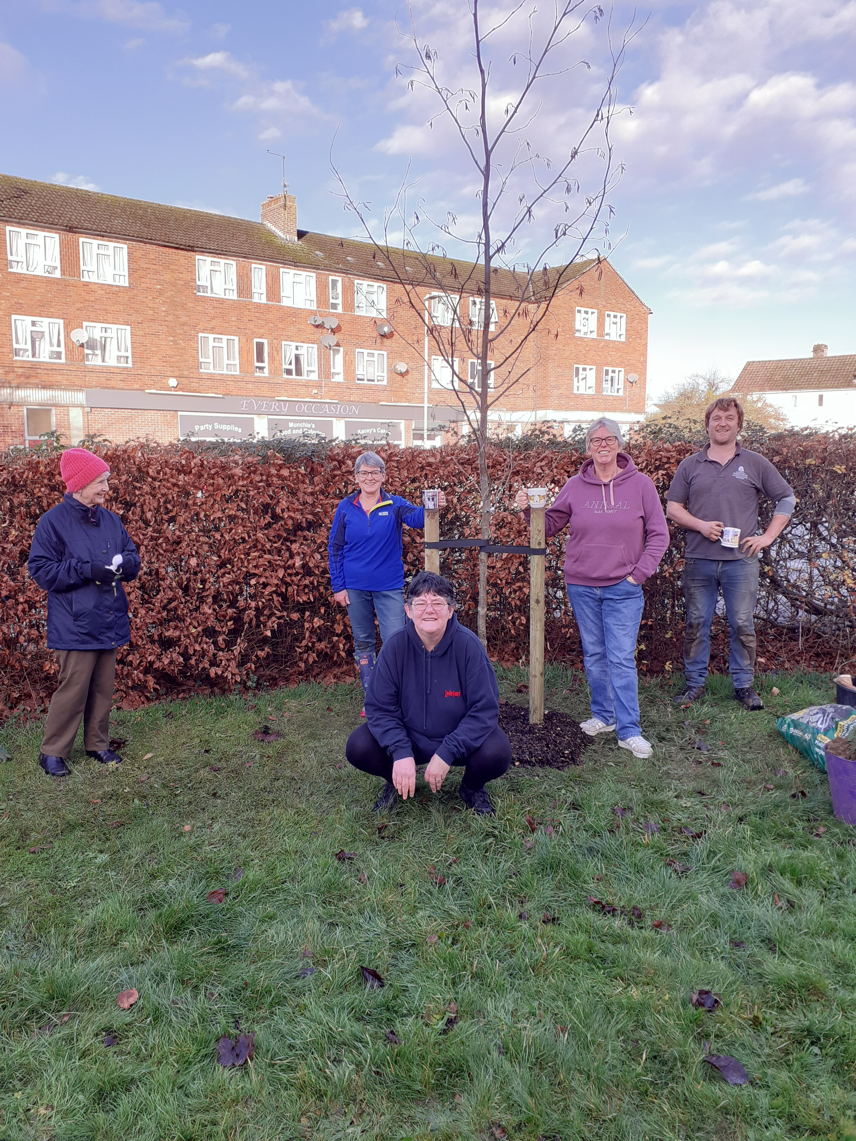
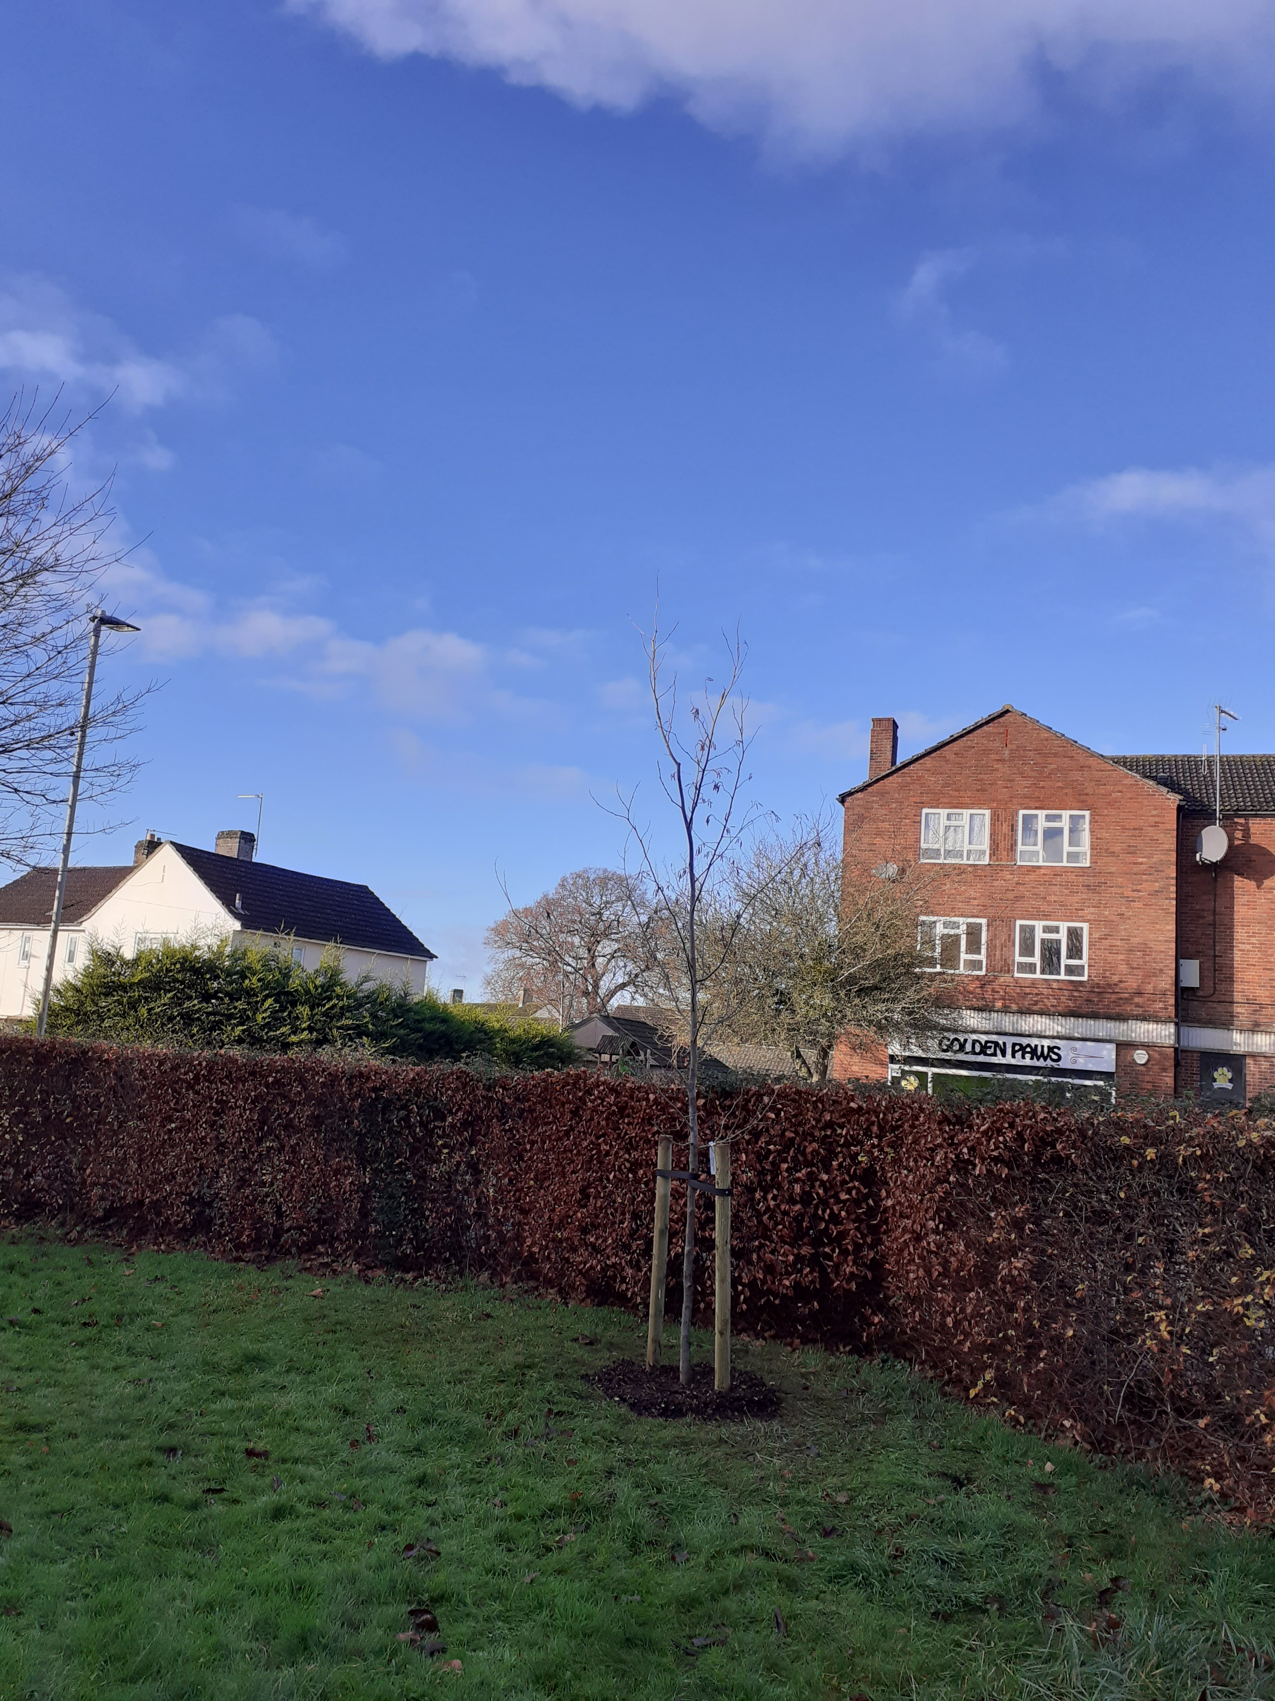
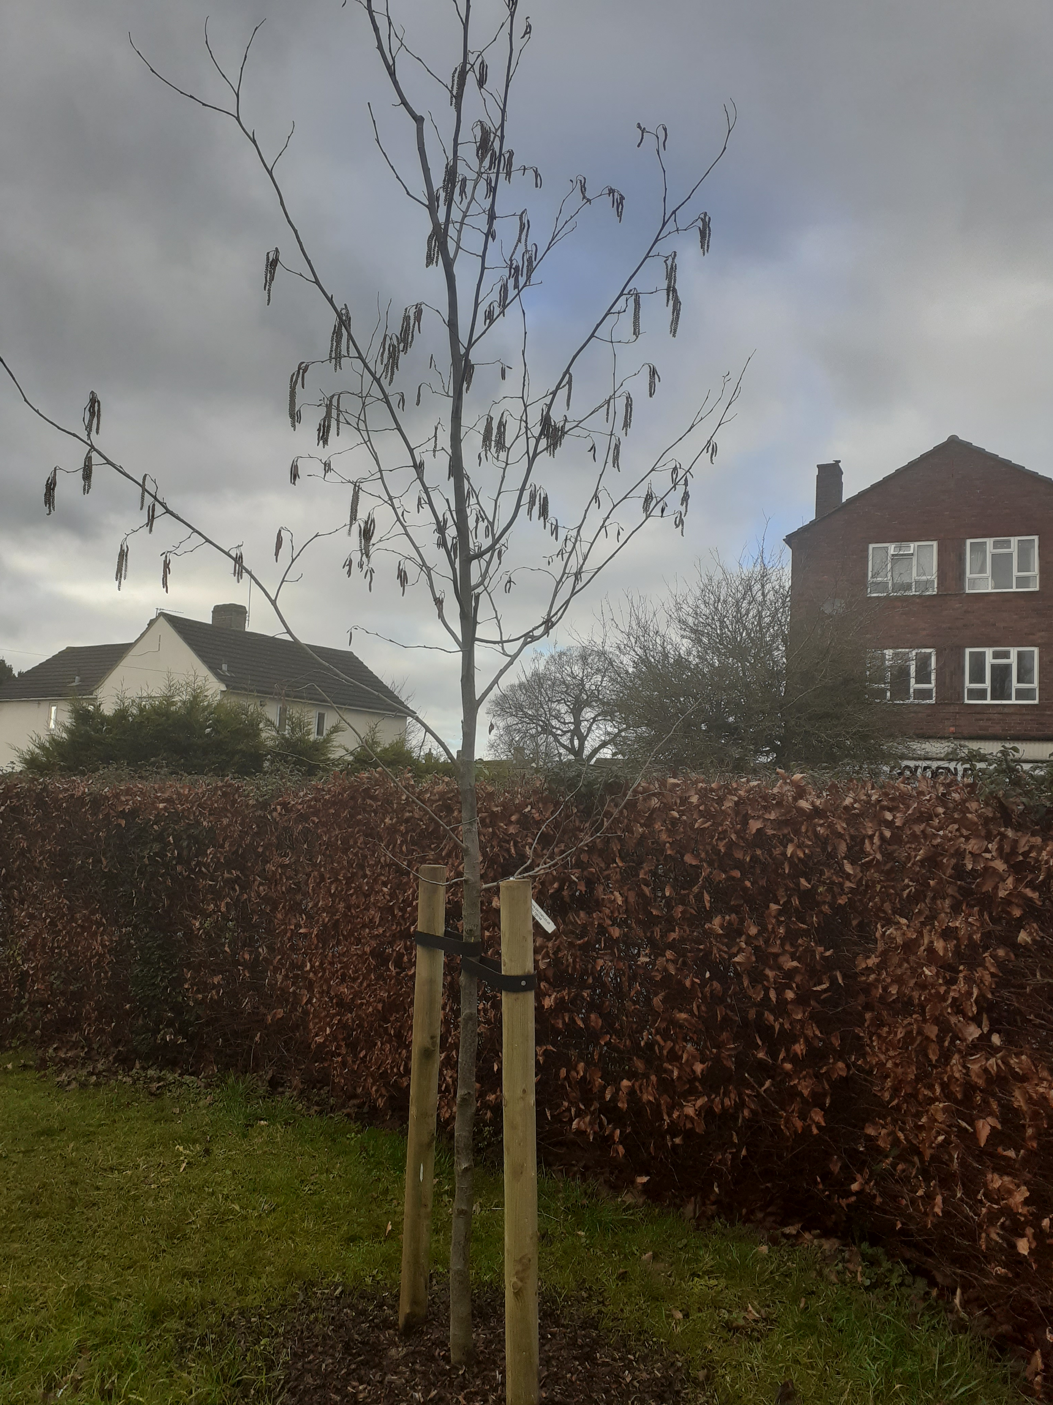
We met John Parker through the Green Fair earlier in the year and invited him to visit the church and advise us on other ways to improve the land. He kindly offered to supply a tree on behalf of Stonehouse Town Council which was planted on 12th December 2020 as part of the Stonehouse Community Arboretum. We have registered it on Countryfile's 'Plant Britain' website.
(alnus spaethii)

Slide 7
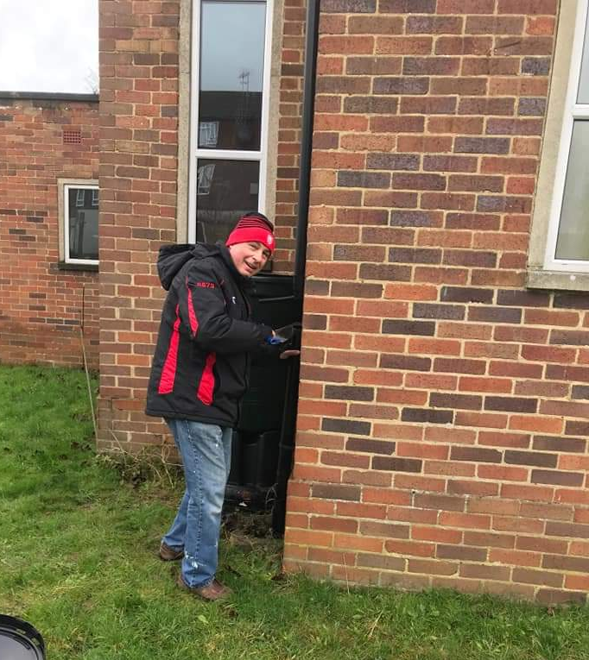
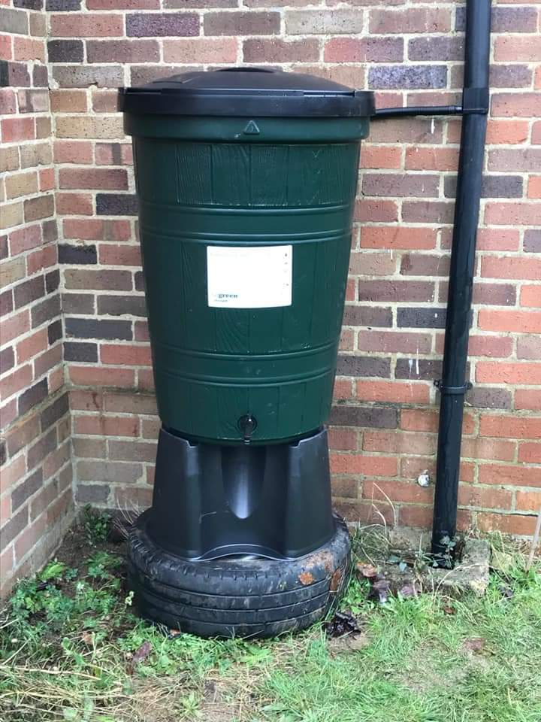
Our first project for 2020 was to install a water butt thanks to a special offer from Severn Trent Water. This satisfies the Eco Church Buildings criteria of 'rainwater collection facilites are installed and used on our premises'. (Note the use of a tyre dumped in the garden as a base!)
Future plans to improve the garden include building raised beds to grow strawberries.

Slide 8
Our Church is in the Gloucestershire Circuit comprising 42 Methodist Churches and as at November 2020 17 Churches had registered as an Eco Church with 10 achieving awards, 3 Silver and 7 Bronze, including us

